Slide 1

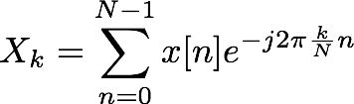
Introduction: FFT
Fast Fourier Transform
Method to compute Discrete Fourier Transform (DFT) for evenly-spaced frequency samples
DFT is sampling of Discrete-Time Fourier Transform (DTFT)
DTFT:
DFT:
FFT:
(continuous frequency)
(discrete frequency)
Same as DFT: just a specific implementation

Slide 2
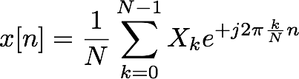
Introduction: FFT
Reconstructing signal from DFT/FFT
Inverse Discrete Fourier Transform (IDFT/IFFT)
DFT:
IDFT:
Notice: N time samples N frequency samples
Two different perspectives on same signal
Given signal length M, can exactly reconstruct from FFT of length N ≥ M
What happens with an FFT of length N < M?
Aliasing

Slide 3
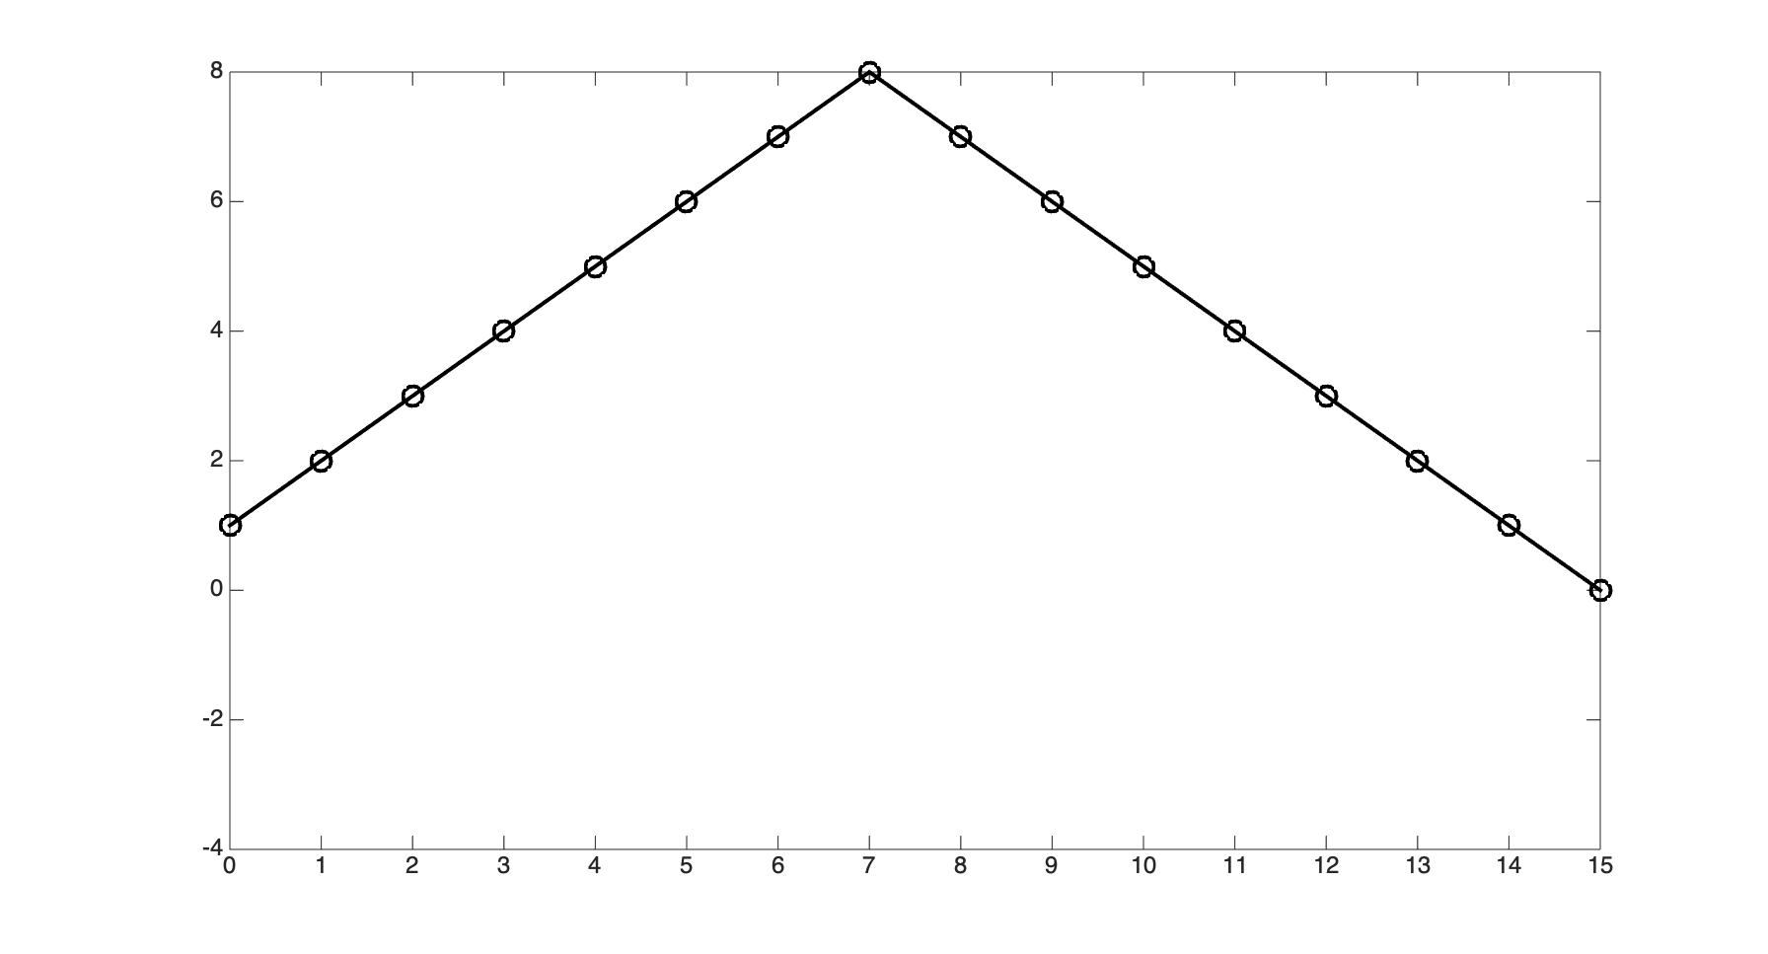
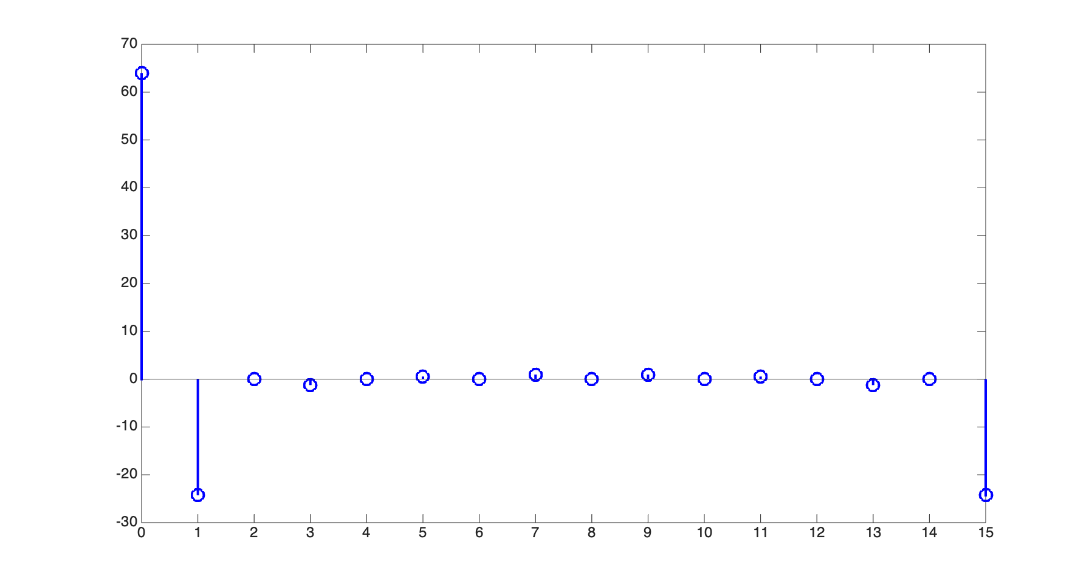
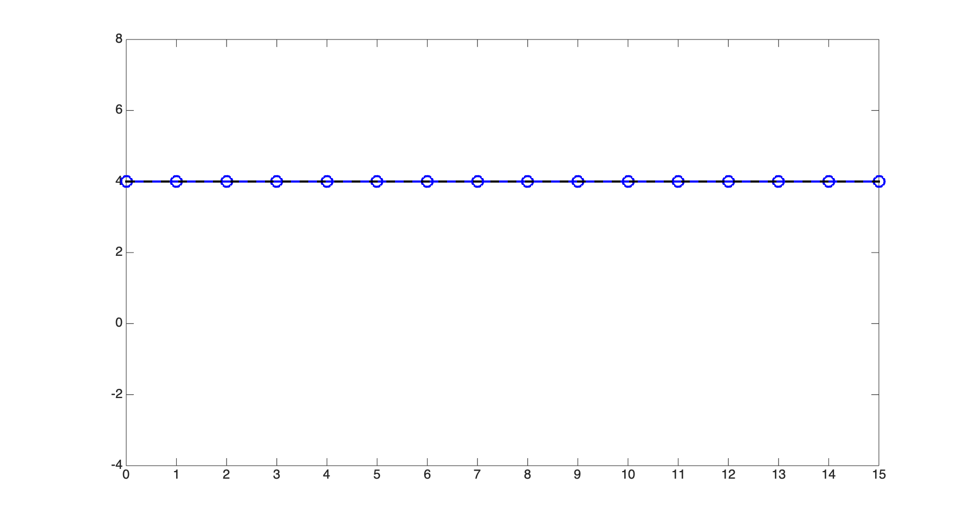
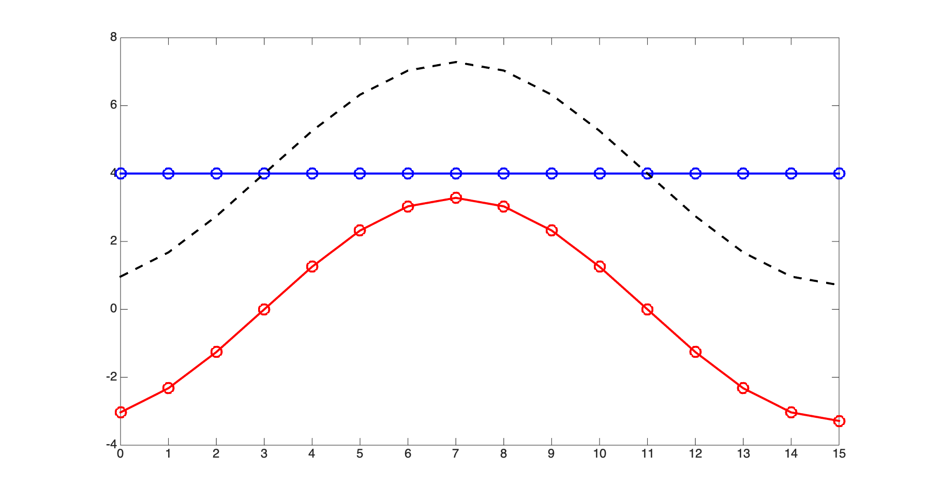
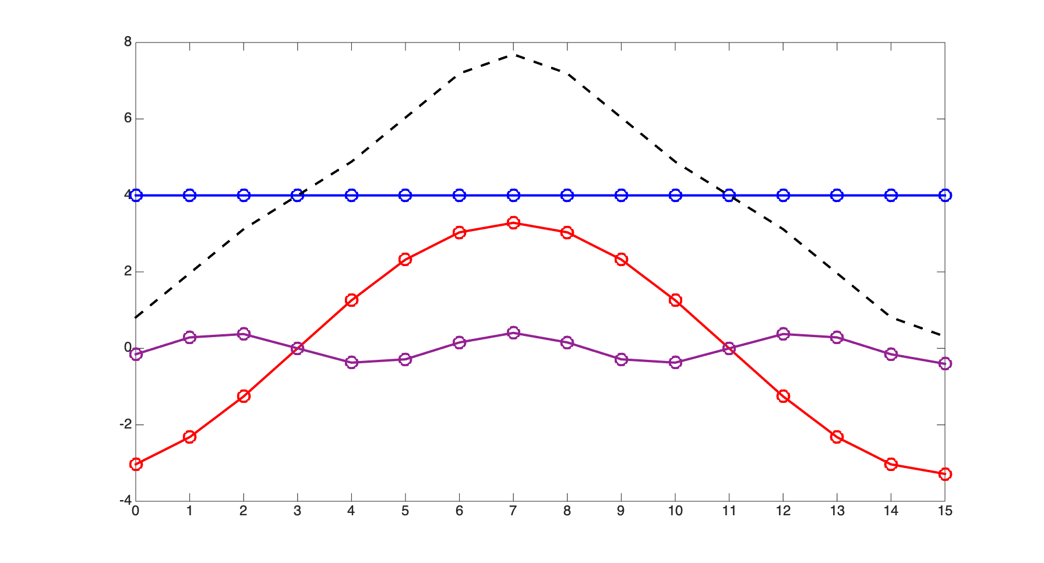
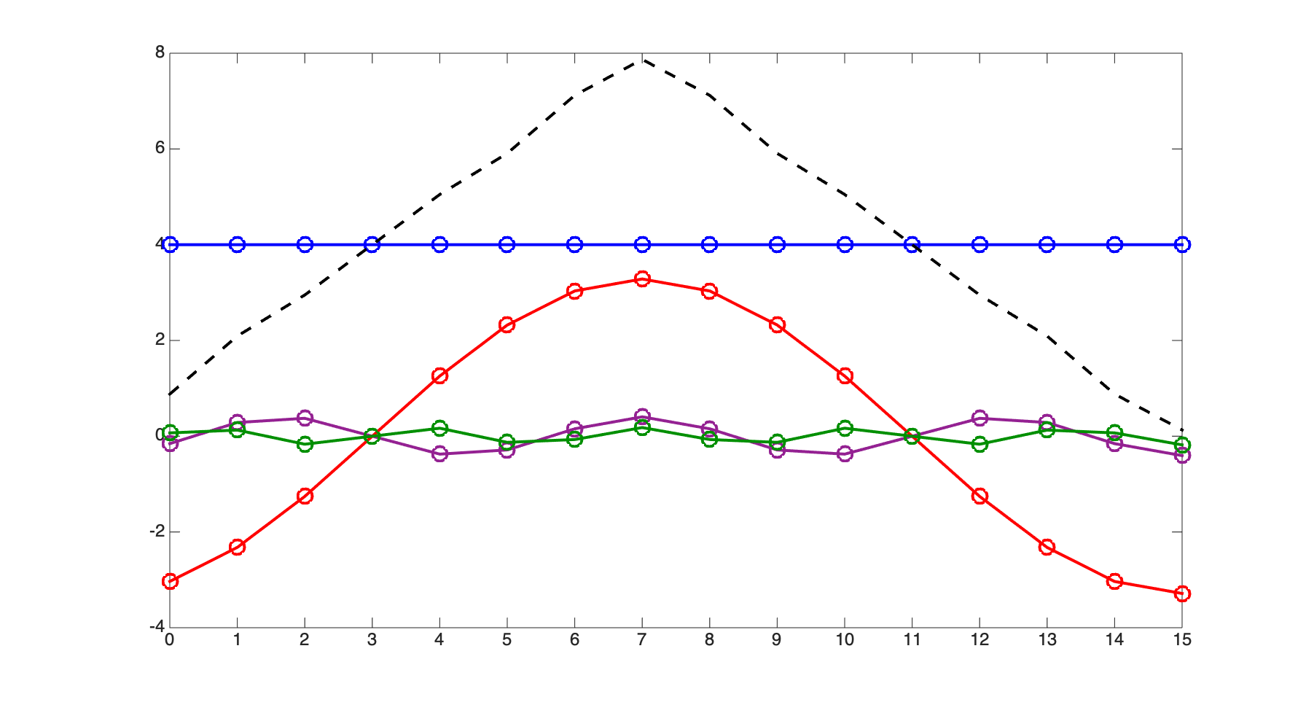
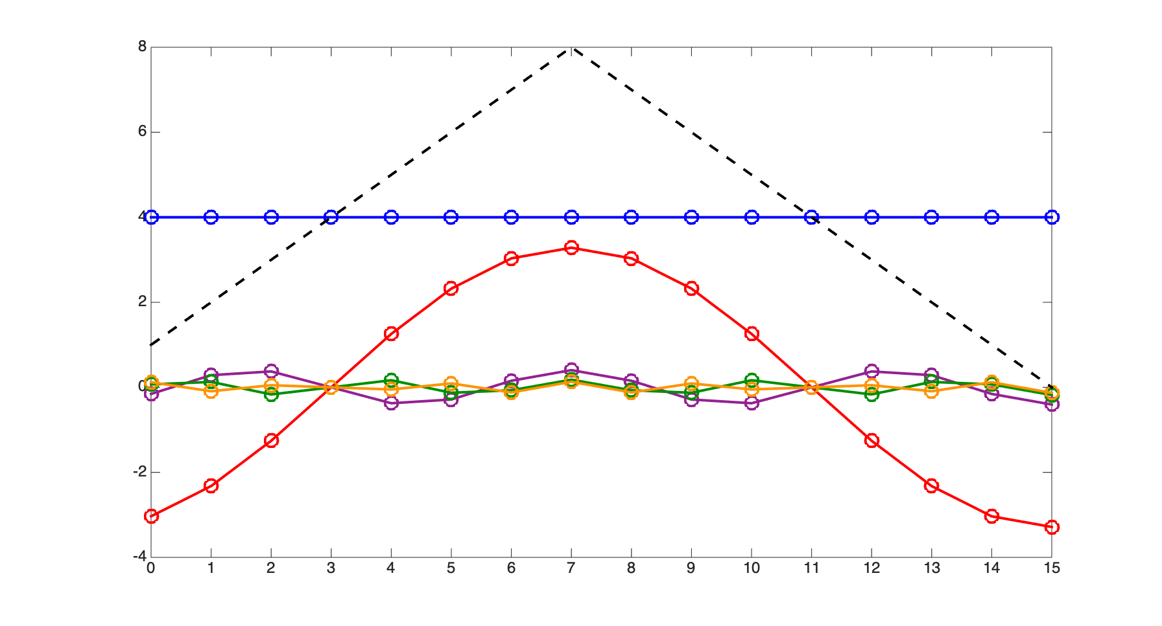
The Fast Fourier Transform
Most common use of block-based processing: the Fast Fourier Transform (FFT)
Efficient computational algorithm for calculating the Discrete Fourier Transform (DFT)
The DFT is a mathematical formula for calculating the frequency content of a signal
Any discrete-time signal of N points can be expressed as the sum of N sinusoids:
Xk (frequency domain)
x[n] (time domain)
Frequency
Amplitude
Phase
0
4.00
0
π/8
1.64
-.875*π
3π/8
0.20
-.625*π
5π/8
0.09
-.375*π
7π/8
0.65
-.125*π
(other components are 0 or redundant)
The DFT calculates the amplitudes and
phases of each frequency component

Slide 4
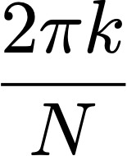

The Discrete Fourier Transform
DFT calculates amplitudes and phases of each sinusoidal component
Frequencies are linearly spaced between 0 and 2π:
Each amplitude/phase measurement is called a bin
Collectively, the N bins are called the frequency domain representation of the signal
for
Xk (frequency domain)
Frequency
Amplitude
Phase
0
4.00
0
π/8
1.64
-.875*π
3π/8
0.20
-.625*π
5π/8
0.09
-.375*π
7π/8
0.65
-.125*π
(other components are 0 or redundant)

Slide 5
The Discrete Fourier Transform
Key point: N time samples ↔︎ N frequency samples
Two different mathematical perspectives on the same signal
Inverse Discrete Fourier Transform (IDFT) converts from frequency domain to time domain
The DFT+IDFT is an exact reconstruction as long as signal length M ≤ DFT length N
x[n] (time domain)
Xk (frequency domain)
DFT
IDFT

Slide 6
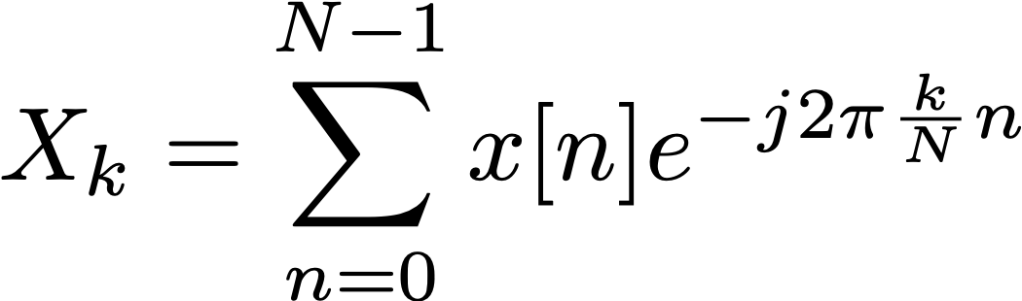
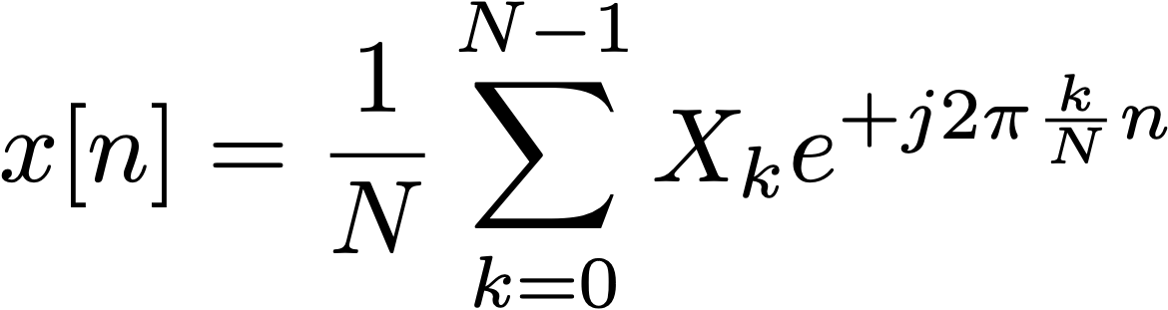
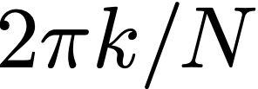
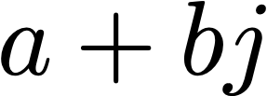
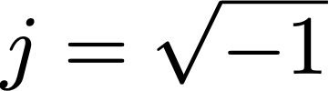
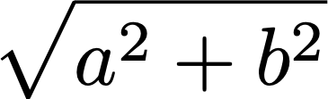

The Discrete Fourier Transform
The mathematical basis of the Discrete Fourier Transform:
N is the size of the DFT
For the FFT, N is almost always a power of 2 (the Cooley-Tukey algorithm)
Each time sample x[n] is a real number
Each frequency bin Xk is a complex number:
Magnitude of the bin is given by:
We usually use magnitude to plot a spectrum or spectrogram of a signal
Phase of the bin is given by:
DFT (FFT)
IDFT (IFFT)
sum, for all values of n between 0 and N-1...
...of signal x[n] multiplied by...
...complex exponential of frequency
time domain → frequency domain
...where k is the bin number
frequency domain → time domain
where

Slide 7


DFT magnitude and phase
Each frequency bin Xk is a complex number:
Magnitude of the bin is given by:
We usually use magnitude to plot a spectrum or spectrogram of a signal
Phase of the bin is given by:
Can also turn the calculation around:
Given magnitude M and a phase 𝜙, calculate real and imaginary components
Real component: Imaginary component:
Remember, frequency resolution depends on DFT size
Bin frequencies are spaced 2π/N apart, where 2π corresponds to the sample rate
For example, N=1024, fs = 44.1kHz: bin spacing is 43.1Hz
where

Slide 8
DFT frequency spacing
Discrete Fourier Transform bins are spaced linearly in frequency
By contrast, musical intervals are defined as ratios in frequency (e.g. 1 octave = 2x)
This means that pitch resolution of the DFT is better for higher bins
This can be a headache for many musical applications
FFT bin frequencies
(linear spacing)
f
2f
8f
16f
32f
1 octave
1 octave
1 octave
ECS7012P Music and Audio Programming • Week 10b

Slide 9

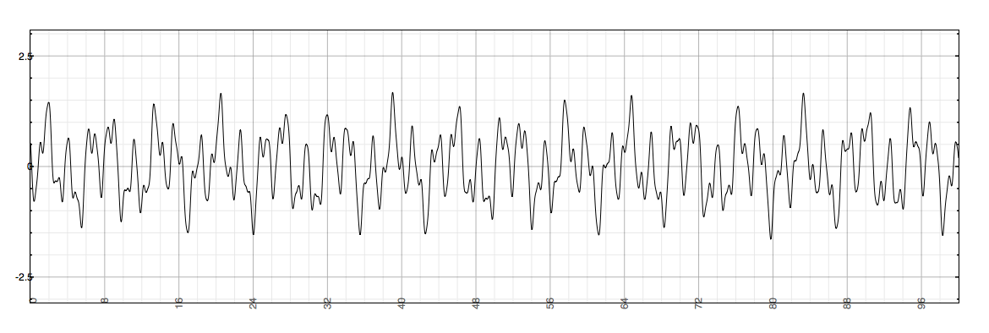
Short-Time Fourier Transform
Short-Time Fourier Transform (STFT) is DTFT of windowed signal
Similarly, can take DFT/FFT for discrete samples of windowed signals
Can break signal into windowed segments
...then (in right circumstances) put it back together

Slide 10
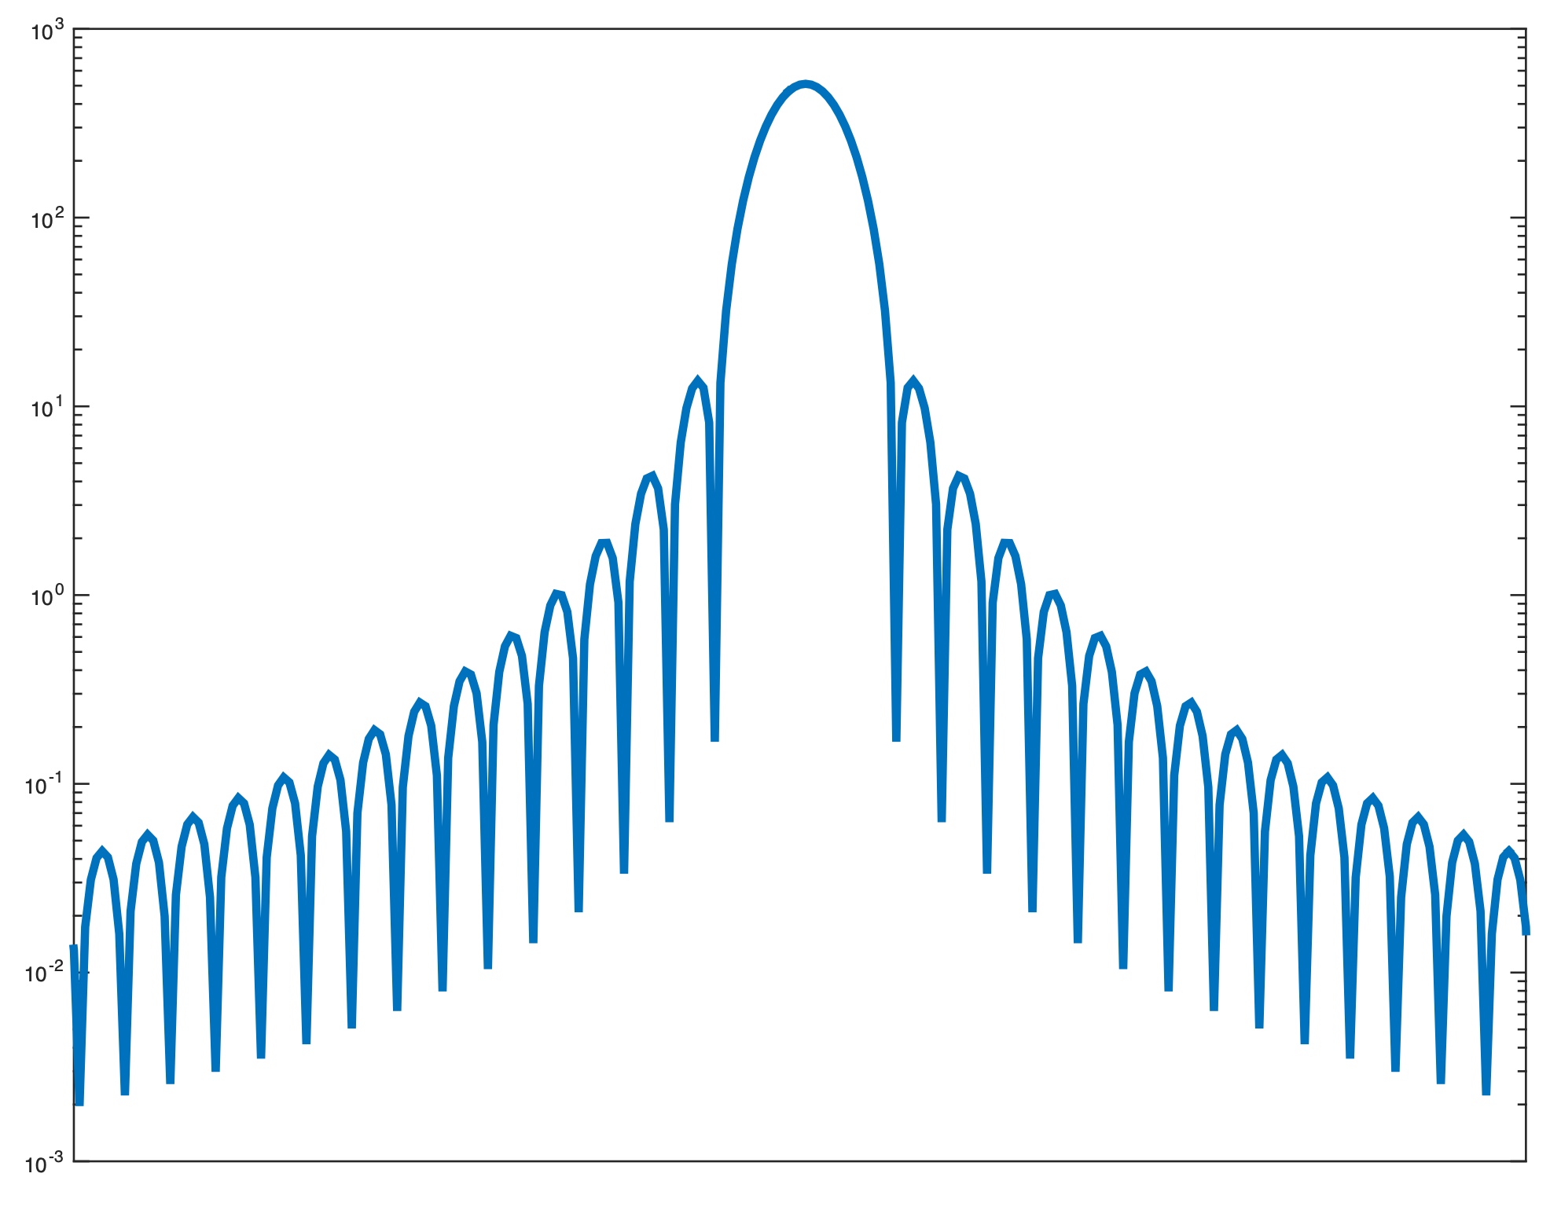
Window spectra
Windowing lets us isolate segment of signal
Cost is smearing of energy in frequency domain
Energy appears at frequencies where it doesn’t exist in original signal
Each frequency component of signal appears as series of lobes
Main lobe: broad peak centred around actual frequency
Side lobes: secondary peaks at other frequencies
Typically want to minimise:
Main lobe width
Side lobe height
Side lobe height
(expressed in dB)
Main lobe width
(expressed in
frequency)
Hann-windowed
spectrum
(frequency smearing)
ideal signal
(all energy at one
frequency)

Slide 11
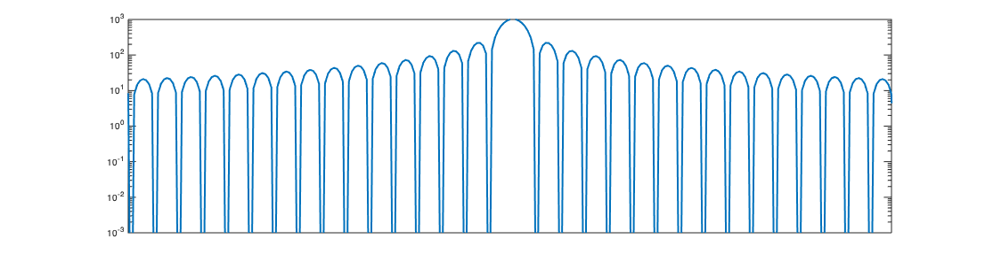
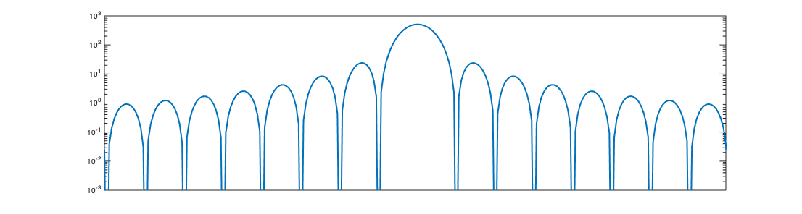
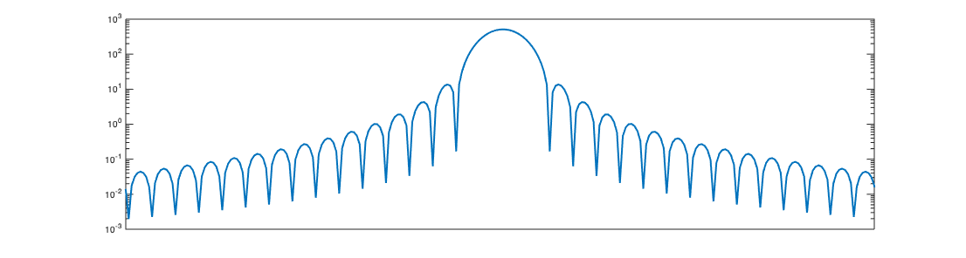
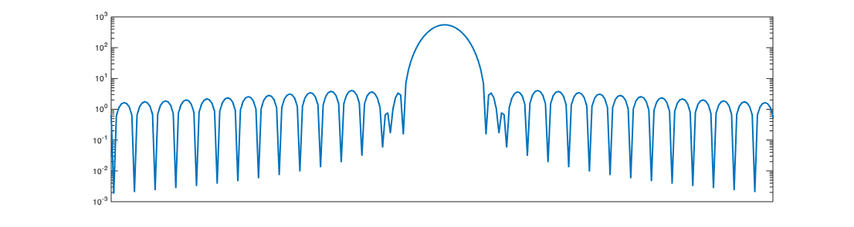
Window spectra
Rectangular
Triangular (Bartlett)
Main lobe width: 4π/N
Side lobe height: -13dB
Main lobe width: 8π/N
Side lobe height: -26.5dB
Hann
Hamming
Main lobe width: 8π/N
Side lobe height: -31.5dB
Main lobe width: 8π/N
Side lobe height: -42.8dB
→ When in doubt: use a Hann window

Slide 12
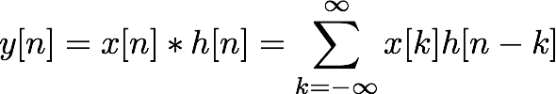

Applications
Many possibilities between DFT and IDFT
Efficient FIR convolution
FIR filter of length N needs N multiplies per sample
Convolution in time = multiplication in frequency
X(z)
H(z)
Y(z)

Slide 13
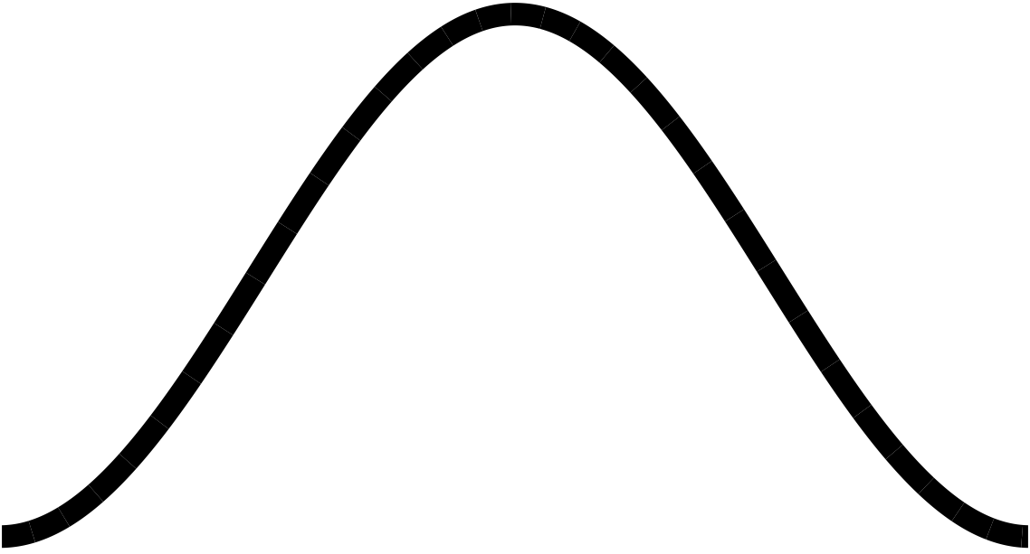
Phase vocoder, part 3
Learn
Modifying signals in frequency domain
Converting frequency to phase
Analysis and synthesis windows
Finally, create phase vocoder effects:
Robotisation (phase zeroing)
Whisperisation (phase randomisation)
Pitch shifting
FFT
effect
IFFT

Slide 14
Phase vocoder: more ideas
Ways to improve the quality of the effects:
When mixing components into an FFT bin, use RMS amplitude rather than linear addition
When mixing components into an FFT bin, find the weighted average of the frequencies
Implement peak tracking to reduce some of the effects of window lobes
Other effects using phase vocoder:
Combine frequency detector with pitch shift to implement auto-tuning
Cross-synthesis: combine frequencies from one signal with magnitudes from another
Noise reduction: suppress frequency components below threshold or matching known profile
As effects become more complex, CPU becomes a limitation
Try larger hop sizes (which may also require larger FFTs)
Pre-calculate frequently used constants (e.g. bin frequencies)
Look for other optimisations to reduce number of multiplies per hop

